Slide 1




TRAININGS OF TSMS
presented by Afife Hande Türkyılmaz

Slide 2
CONTENT
RTC Facilities of TSMS
Trainings of TSMS
    Trainings that we provide on a regular basis
    Trainings that we provide for specific countries
3. Graphics on Trainings
    Distribution of Number of Trainings
    Distribution of Number of Participants
Training Activities in 2017

Slide 3
Regional Training Centre
  Turkey was recognized as WMO 6th Regional Training Center in 2001 by agreement between WMO and TSMS.
  We have Facilities in Ankara, İstanbul, and Alanya (Antalya).

Slide 4
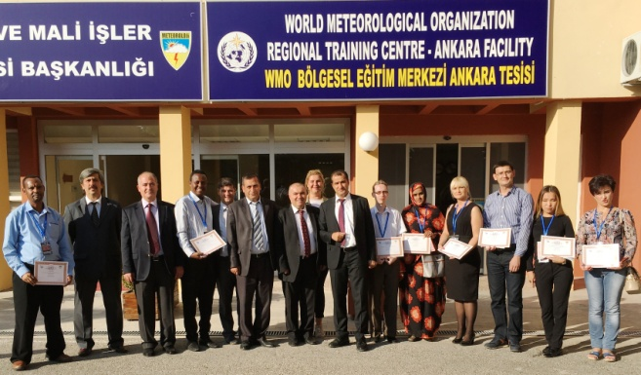
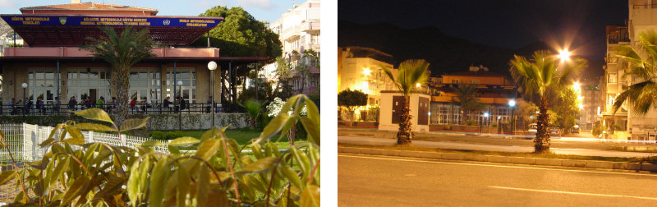
Facilities of Regional Training Centre

Slide 5
Regional Training Centre
We provide international organizations specifically in the field of
  weather forecast,
  meteorological radars,
  numerical weather prediction,
  upper air observing systems,
  agricultural meteorology and
  climate change

Slide 6
TRAININGS
Trainings that we provide on a regular basis
Trainings that we provide for specific countries

Slide 7
Trainings that we provide on a regular basis
Training on Weather Radars
(2005-2006-2007-2008-2010-2012)
Training on Meteorological Telecommunication and METCAP Software (2004-2006-2008-2010-2016-2017)
Training on Upper Air Observing Systems (2008-2010-2012)
Training on Basics of Calibration
(2011-2013-2016)

Slide 8
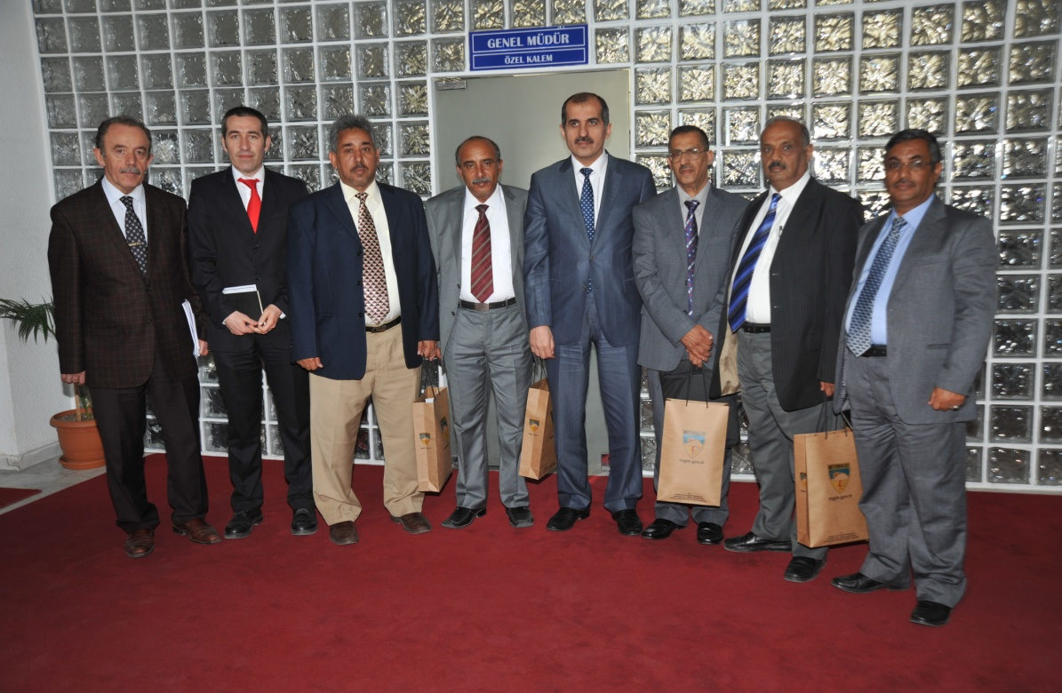
Specific trainings that we provide
Training Course on Development and Evaluation of Meteorology Performance
7-18 April 2014 in Ankara Facility of RTC
5 high level Yemen Meteorological Personnel

Slide 9
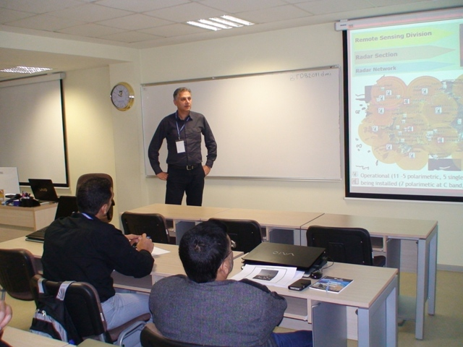
Specific trainings that we provide
Training on Advanced Forecasting
26 May and 13 June 2014 in Ankara Facility of RTC
16 Saudi Arabian Meteorological Personnel

Slide 10
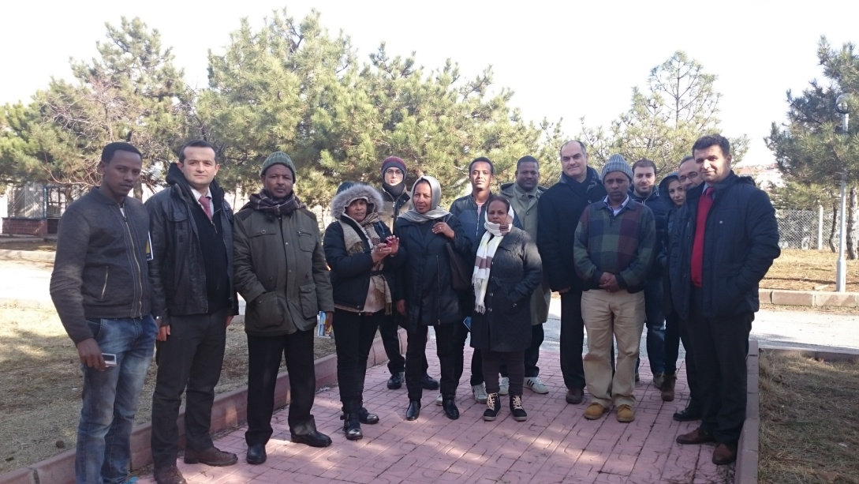
Specific trainings that we provide
Training Course for the Staff of Ethiopian Meteorological Service
19 and January 2016 in Ankara Facility of RTC
19 Ethiopian Meteorological Personnel.

Slide 11
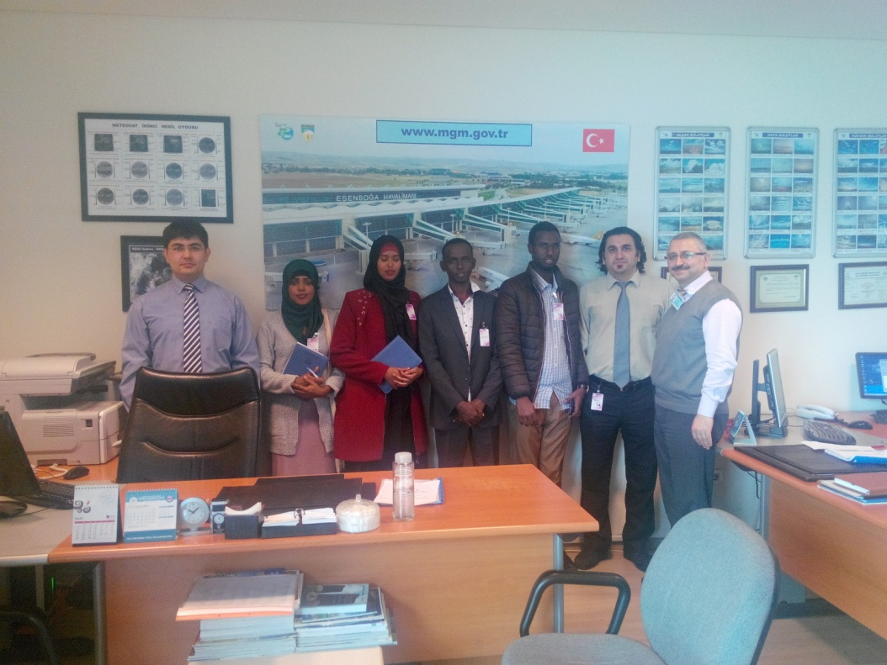
Specific trainings that we provide
Training Course for the Staff of Somali Civil Aviation and Meteorology Authority
21 March and 01 April 2016 in Ankara Facility of RTC
5 Somali Meteorological Personnel

Slide 12
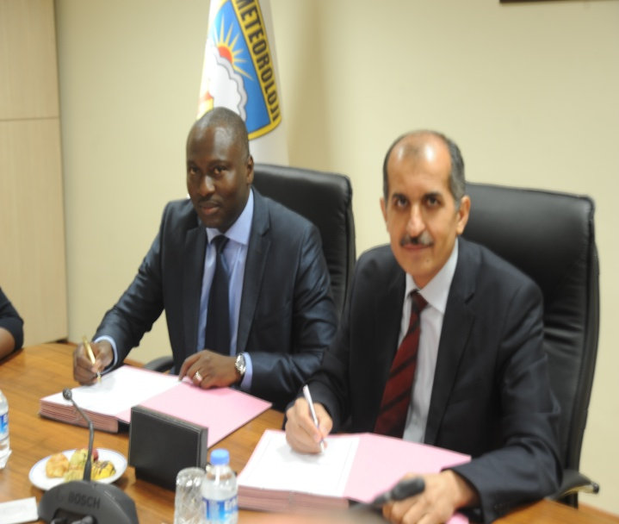
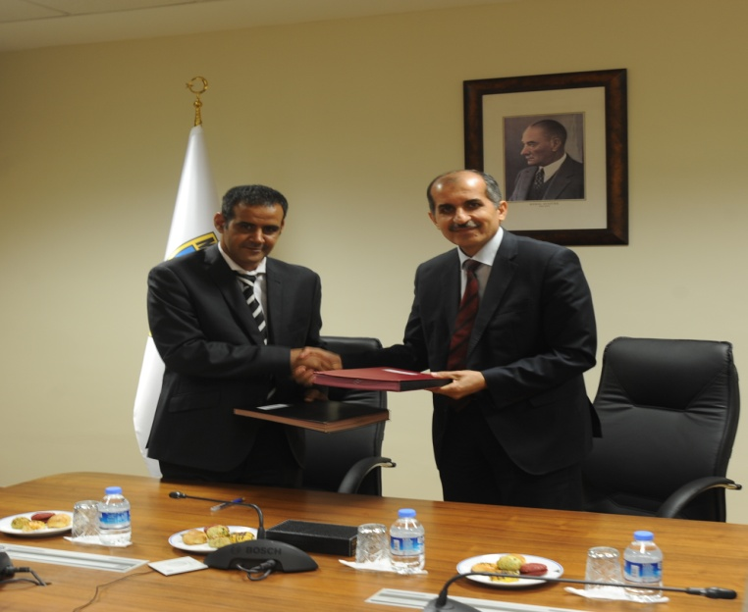
Specific trainings that we provide
Training Course for the Staff of Mauritania Meteorological Office and Senegal Civil Aviation and Meteorology Authority
30 May and 3 June 2016 in Ankara Facility of RTC
6 Mauritania and 3 Senegal Meteorological Personnel

Slide 13
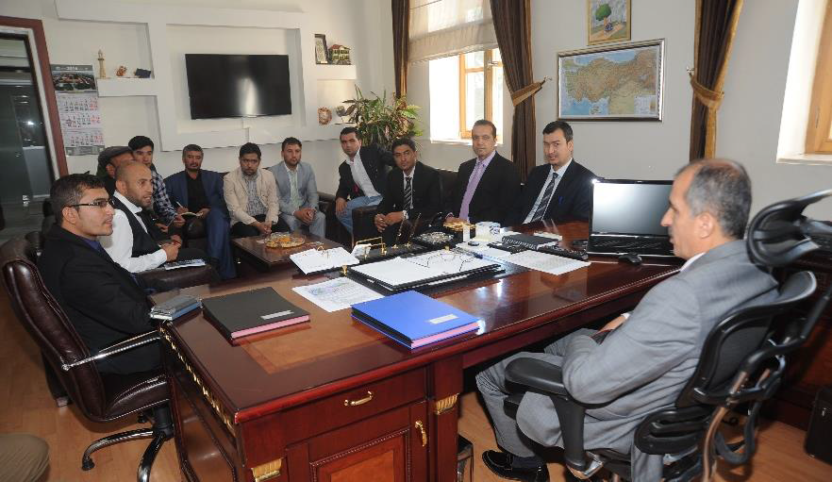
Trainings for Afghanistan Meteorological Department (AMD)
Quality Management Training (15 Aug-9 Sep 2016, 10 AMD Personnel)
Observer Training (28 Nov-22 Dec 2016, 11 AMD Personnel)
Forecaster and Satellite Meteorology Training (06 March-14 April 2017, 11 AMD Personnel)

Slide 14
Distribution of Number of Trainings

Slide 15
Distribution of Number of Participants

Slide 16
Trainings in 2017
Training Course on Operation and Maintenance of Radar Systems
  Marmaris, September-October
Training Course on Establishment, Operation and Maintenance of AWOS
  Alanya, September-October
Training Course on Operation and Maintenance of Radiosonde Systems
  İstanbul, September-October
Global FFGS Workshop
  Antalya, October

Slide 17
THANK YOU FOR LISTENING

